Slide 1
Kolarctic CBC Project Financial management & reporting
Financial management
Expenditure verification
Financial flows
Irregularities, fraud and corruption
Reporting routines
Financial report and templates
Timetables
25.2.2019

Slide 2
I. Financial Management
Partner shall keep appropriate accounting and double-entry bookkeeping systems
Project shall have a separate cost center/project code in the bookkeeping records
Cost must be able to identify and verify
The auditor shall have an access to documents
Separate bank account should be opened for the project
- Accrued interest shall be reported within Final report (only not public organisations)
Eligibility starts from the start date of the project, no binding commitment before that

Slide 3
Eligible and ineligible project costs
Eligible costs:
Incurred during the implementation period of the project
exception is made for project’s Preparatory costs and Final costs
Indicated in the project budget
Necessary for the project implementation
Identifiable and verifiable
Reasonable and justified
Supported by invoices
Ineligible costs:
Fines and financial penalties
Currency exchange rate losses
Costs already financed in another framework (for example by the EU budget)
Contribution in kind
any provision of non-financial resources free of charge by a third party, e.g. payment in kind, voluntary work etc.
Provisions of losses or liabilities
Duties, charges and taxes
including VAT, except where non-recoverable under the relevant national tax-legislation
Debts and debt service charges (interests)
Loans to third parties
Purchases of land or buildings for an amount exceeding 10% of the total eligible costs of the project

Slide 4
Use of EUR
Payments to projects from MA only in Euro
Amounts claimed in the financial reports have to be presented in currency used in accounting records and converted into Euro
Use the official InforEuro monthly exchange rate published by EC
http://ec.europa.eu/budget/contracts_grants/info_contracts/inforeuro/index_en.cfm
Exchange rate of the month during which the expense was recorded in the accounting records, not the month when the expense was incurred or paid
Exchange rate with all decimals (e.g. SEK/EUR 0,10391).

Slide 5
Procurement
All equipment, purchases and external services has to be bought/leased through tender procedures (price comparison).
Tender made according to the national procurement rules and Programme rules.
Framework contract of the home organisation can be used (if awarded according to the criteria set for procurement procedures of the Kolarctic CBC)
All tender procedures shall be documented and the selection criteria justified.
Auditor shall verify the procurements within the projects´ Interim Reports and the Managing Authority may carry out ex post checks on Lead Partner´s and Partner´s compliance with the rules.

Slide 6
Procurement
Finland and Sweden (public and private organisations)
Value of the procurement over the national threshold values
National legislation of the public procurement to be obeyed
Purchases with value from 3 000 € / 30 000 SEK to national threshold value
Request for offer in writing from 3-5 suppliers
Procedure to be documented, criteria for the decision justified
Purchases with value under 3 000 € / 30 000 SEK
The price comparison made from several potential suppliers (e.g. by phone/e-mail/from webpages).
Shortly documented

Slide 7
Procurement
Russia
Public organisations follow the national legislation of the public procurement
Private organisations shall obey the regulations set up in Annex VI of the Grant Contract “Award of procurement contracts by Russian private beneficiaries”
In addition to these regulations, Programme has set following rules:
Purchases with value from 3 000 € / 210 000 RUB (rate 1 €=70 RUB) to national threshold value
Request for offer in writing from 3-5 suppliers
Procedure to be documented, criteria for the decision justified
Purchases with value under 3 000 € / 210 000 RUB
The price comparison made from several potential suppliers (e.g. by phone/e-mail/from webpages).
Shortly documented

Slide 8
Procurement
Norway
Value of the procurement over the national threshold values
National legislation of the public procurement to be obeyed
Purchases with value from 100 000 NOK to national threshold value
Request for offer in writing from 3-5 suppliers
Procedure to be documented, criteria for the decision justified
Purchases with value under 100 000 NOK
The price comparison made from several potential suppliers (e.g. by phone/e-mail/from webpages).
Shortly documented

Slide 9
Expenditure verification
Each partners realized cost shall be verified by an external auditor within each financial report
In Norway only within the last one for the whole implementation period
Norwegian LP’ auditor shall verify that the sum in Consolidated financial report is equal with the individual verification reports from the partners (fills in only EV3)
Project can use the external auditor of their organization or select a new one (procurement rules to be obeyed)
Auditor shall fulfill the requirements of the Programme:
Presented in Annex IV of the Grant Contract (EV1 Expenditure and Revenue verification procedure)
Partners shall inform the name of the selected auditor to MA within 6 months of the project start (LP fills in the ”Nomination of auditor” form)
Partners from the same country can use a common auditor
Partner should provide all needed project documents

Slide 10
Expenditure verification
The reporting documents for the auditor available on http://kolarctic.info
EV1 Expenditure and revenue verification procedure
EV2 Service contract for the expenditure and revenue verification
Signed, scanned copy to be loaded in PROMAS
EV3 Expenditure and revenue verification report
Signed, scanned copy to be loaded in PROMAS and a paper version (copy or duplicate) to be submitted to MA
EV4 Checklist for the expenditure verification
Signed, scanned copy to be loaded in PROMAS
EV5 List of factual findings
Signed, scanned copy to be loaded in PROMAS
EV6 Report on suspected fraud and/or established fraud
Auditor must submit direct to the Managing Authority (signed, original)
All documents shall be filled in in English
Auditor verifies at least 65 % of the total costs and 10 % of each budget headline.
Required documents must be attached to Interim report in PROMAS
Additional verifications can be conducted also by EC, European Anti-Fraud office, Court of Auditors, Group of Auditors and Managing Authority as well as representatives from the national financiers.

Slide 11
Payment flows from the MA
Pre-financing to the project
Option 1: 30 % of the total grant (EU, RU+FI state co-financing) or
Option 2: 80 % of the first year´s grant
Interim payments
Option 1: Next payment the share of the grant calculated from the eligible, approved costs
Option 2: 80 % of the second year´s grant
Final payment (min. 20 % of the grant)
To be paid after the final report has been approved
Payments latest after 45 days after the Interim/Final report has been approved and MA received the Payment request.
Payment request is submitted by LP in PROMAS, signed paper version to be submitted to MA
Norwegian Kolarctic financing requested separately from Kolarctic BO in Norway

Slide 12
Recovery
Any amount paid excess shall be paid back to MA
MA sends a recovery order to Lead Partner who has to pay it within 45 days
Lead partner recovers the amounts from the Partners
During the implementation of the project, unduly paid amount can be deducted direct from the next payment
Recovery e.g. if
Wrong procurement procedure used
Visibility rules not followed
Errors on calculations
Costs/actions outside the implementation period
In the case of irregularity found during the implementation, the recovered/rejected amount can be deducted from the project budget

Slide 13
Irregularities, fraud and corruption
All partners have a responsibility
To be aware that funds are used for the purpose they are meant according to the Project plan and Grant contract
To prevent and mitigate the risk of irregularities, fraud and corruption
Minimize the risk of conflict of interest
Irregularity can be either administrative and/or financial mismanagement that leads to the misuse of the funds
Intentional > neglecting the rules, clear carelessness
Non-intentional > misunderstanding of the rules, incorrectly filled forms, clerical mistake etc.
Fraud
Planned misuse of the funds, purpose to get additional benefit (on personal or organizational level)
Criminal act
Has juridical consequences
Can be identified e.g. in following cases, if knowingly
Splitting purchase in order to avoid/minimize tendering procedure or favor certain bidder
Criteria set to favor certain bidders
Unequal information to the bidders, leaking information to favored bidder
Manipulating timesheets, reporting the work that does not include to the project, adding fictitious project issues to the travels not related to the project

Slide 14
Irregularities, fraud and corruption
Corruption
Acting in a way that damages or is likely to damage Kolarctic CBC Programme´s financial interests
Active corruption; Promising or giving the bribe or anykind of advantage
Passive corruption; Accepting such a bribe or advantage or by receiving it
In the case of detected irregularities or fraud, MA can cut the budget with an ineligible amount in order to prevent reuse.
Suspected fraud can lead to suspension of the project during the investigations
Managing Authority encourages all persons involved to the projects actively to report suspects of any kind of wrongdoing or fraud to the MA. Announcement of the possible irregularity can be sent to the Programme´s e-mail kolarctic@lapinliitto.fi or anonymously to the post address Lapin liitto, Kolarctic CBC, PL 8056, FI-96100 Rovaniemi. All reports are handled with confidence in the Managing Authority.

Slide 15
II. Financial report
Financial Report is part of Interim Report
LP informs partners of the reporting periods and set due dates for partners to submit their reports to the LP
Templates for Financial Report are available on http://kolarctic.info .
All financial reporting documents has to be filled in by each project’s partner.
All documents has to filled in in English.
The Financial Report with the required annexes has to be attached by LP to the Interim Report in PROMAS.
Some documents must be printed out, signed and sent to the MA.

Slide 16
How to make the report
Collect the data to reporting documents during the reporting period, monthly update from the bookkeeping records
Errors can be corrected during the period
MA may ask financial updated during the period
Lead Partner shall follow up the cost of the Partners
Regular reports to LP?
Pre-financing from LP to Partners > can be connected to realized costs
Preparation of the report
Filling in all templates (+narrative part)
Material to auditor early enough, audit may take time
LP makes the consolidated report to MA (summary of the costs in project level)
LP needs the Partner reports in time to be able to report to MA in due time

Slide 17
Financial report: Requirements
The period of the Financial Report has to be equal with the period stated in the written Interim Report
All reported costs are according to the project budget – there are not costs which are not budgeted
Only costs that are recorded into the bookkeeping records during the reporting period shall be included into the report
All reported costs shall be verified
Costs are reported in the currency used in the bookkeeping records and converted in Euro (InforEuro monthly exchange rate)
Figures in the Expenditure and Revenue Verification Report and Financial Report with supporting documents have to match

Slide 18
Templates for the financial reporting
Annex 1 Financial report with General ledger specification
Excel-file to be loaded in PROMAS, signed paper version to be submitted to MA
Annex 2 Personnel cost specification
Signed, scanned copy to be loaded in PROMAS
Annex 3 List of purchases
Signed, scanned copy to be loaded in PROMAS
Annex 4 Preparatory costs (if budgeted)
Signed, scanned copy to be loaded in PROMAS
Annex 5 Templates for the last interim report
Signed, scanned copy to be loaded in PROMAS
Annex 6 Timesheet
Don’t need to be submitted to the Managing Authority, but they have to be presented to auditor for verification
Annex 7 Consolidated financial report
Filled in only by LP!
Excel-file to be loaded in PROMAS, signed paper version to be submitted to MA
Each annex has sheet “Instructions” – read them!
Detailed instruction of the financial reporting are in the Project Implementation Manual

Slide 19
Annex 1 Financial report with General ledger specification
Report of the realized costs of the reporting period
Filled in by each partner
Excel-file to be loaded in PROMAS, signed paper version to be submitted to MA
Costs are allocated to the budget lines according to the approved budget (annex of the Grant Contract)
Total amounts per each budget line in 1.1. Financial report has to be equal with those in 1.2. General Ledger specification
Sheets:
1.1. Financial report
1.2. General ledger specification
1.3. Financing

Slide 20
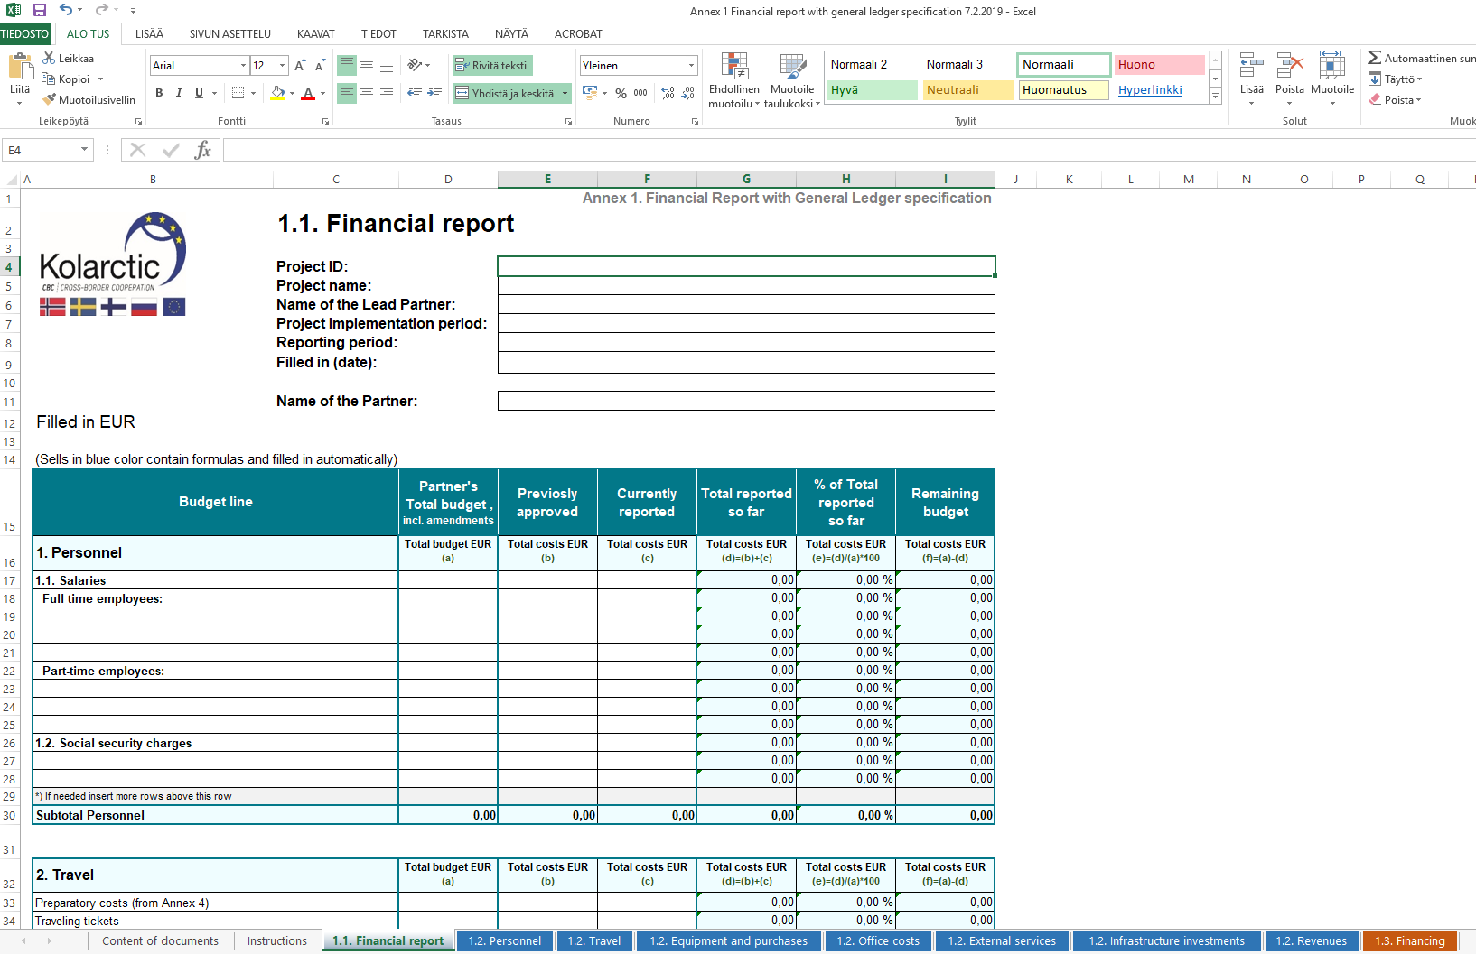
Annex 1: 1.1. Financial report
Fill in the budget of the partner, update also sub-headlines according the approved budget. If amendments were done fill in updated budget.
New sub-headlines may not be added
Add amounts of earlier approved by MA costs, if any
Add amounts of the current reporting period
Add Indirect costs according to approved % in the budget
All amounts in EURO

Slide 21
Annex 1: 1.2. General ledger specifications
Each expense is indicated separately and allocated to the appropriate main budget line in the sheets:
Personnel
Travel
Equipment and purchases
Office costs
External services
Infrastructure investments
Revenues
The structure is equal in each sheet.

Slide 22
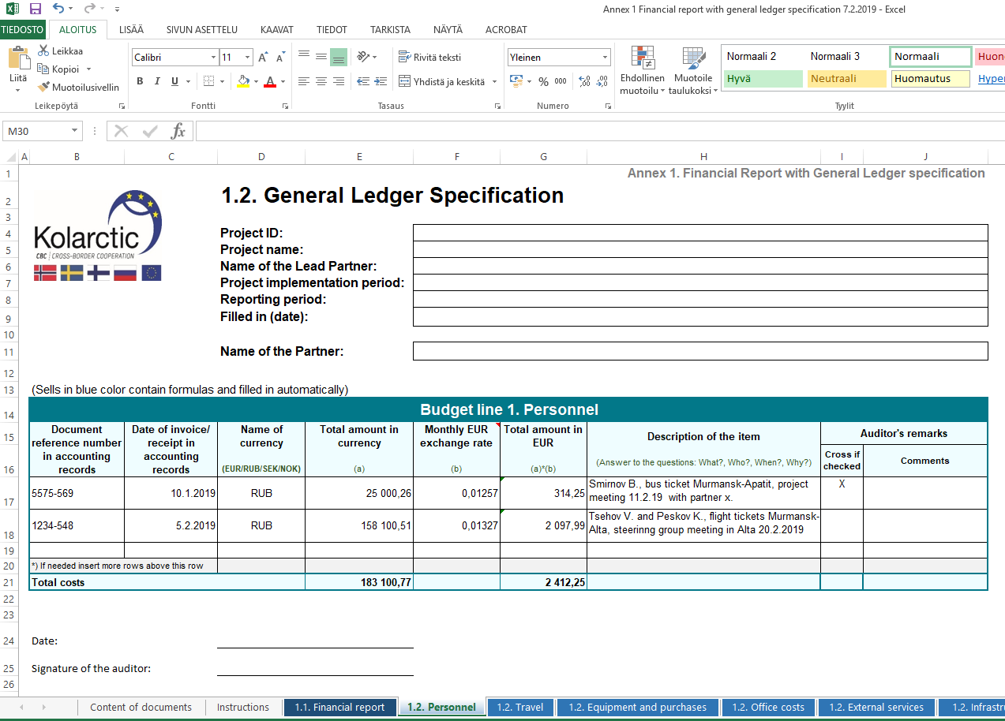
Annex 1; 1.2. General ledger specification
Use InforEuro monthly exchange rate published by EC
Description gives the justification to the cost, makes easier for the auditor to check the costs
Auditor will mark the checked items and comment if needed
Euro amount transferred to sheet 1.1. Financial report

Slide 23
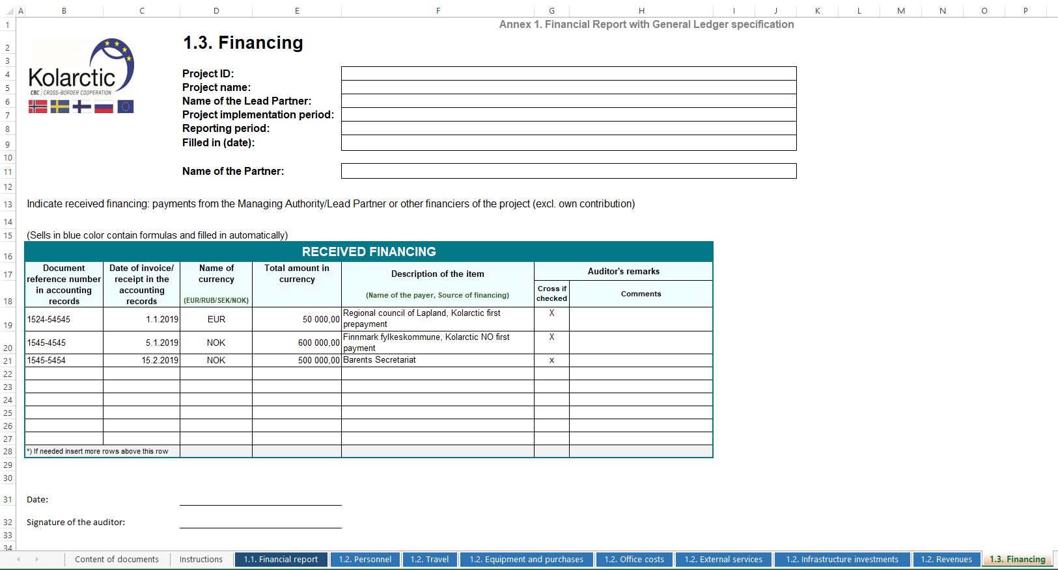
Annex 1; 1.3. Financing
Payments from MA/LP and other financiers (excl. own contribution)

Slide 24
Annex 2. Personnel cost specification
Filled in by each partner
Signed, scanned copy to be loaded in PROMAS
Sheets:
2.1. Personnel list
2.2. Salary specification

Slide 25
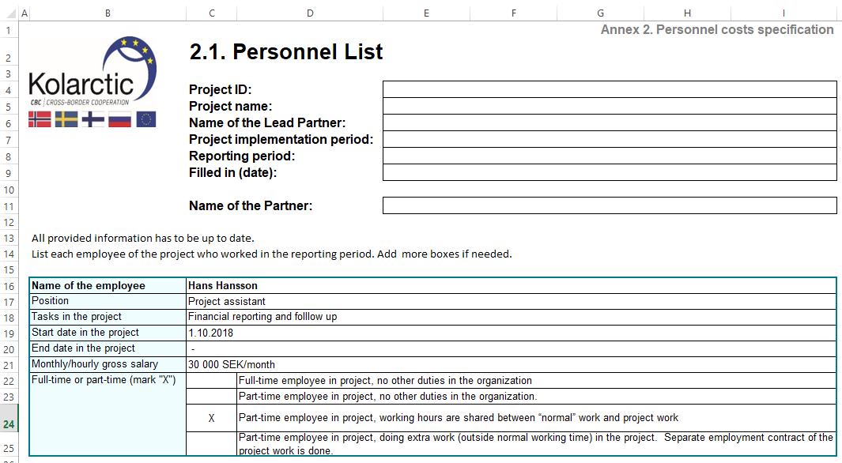
Annex 2. Personnel cost specification
To be updated within each report
List of all employees working in the project (full-time or part-time)
Data in the personnel list shall be up to date and match to the reported salaries

Slide 26
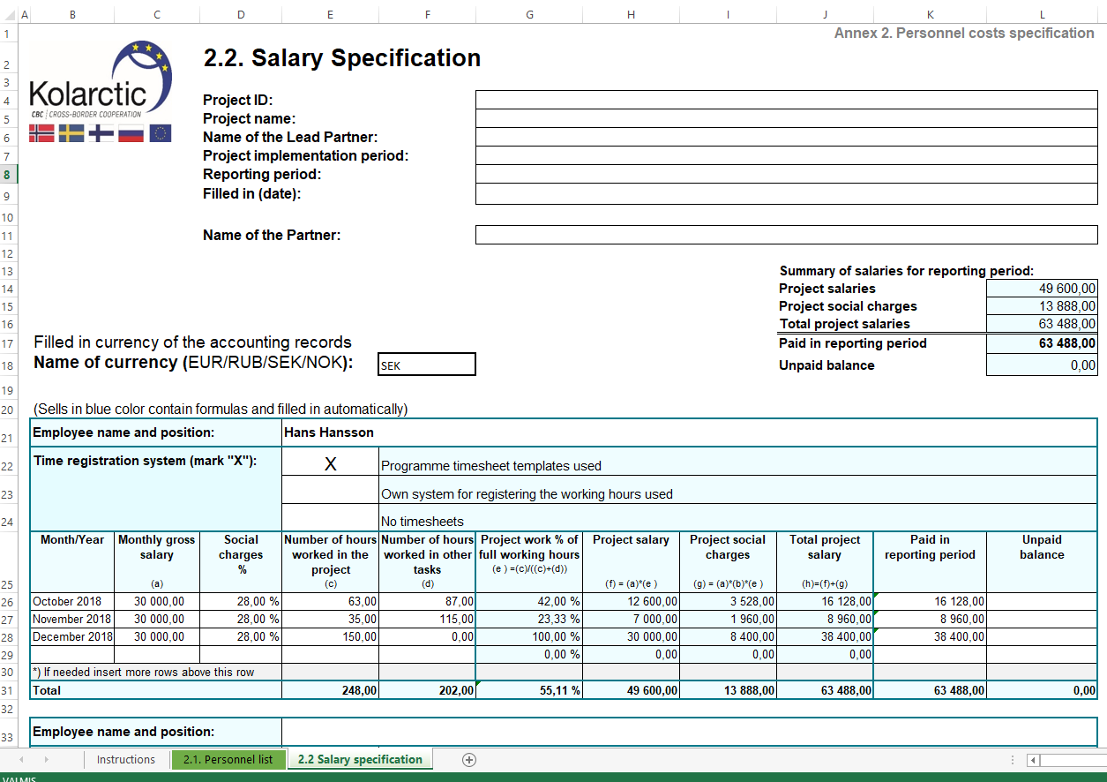
Annex 2. Personnel cost specification
Paid amount should be equal with the General ledger specification 1.2. Personnel
Number of hours worked in the project should be equal with timesheets.
If full time worker, indicate amount of hours according to the employment contract.

Slide 27
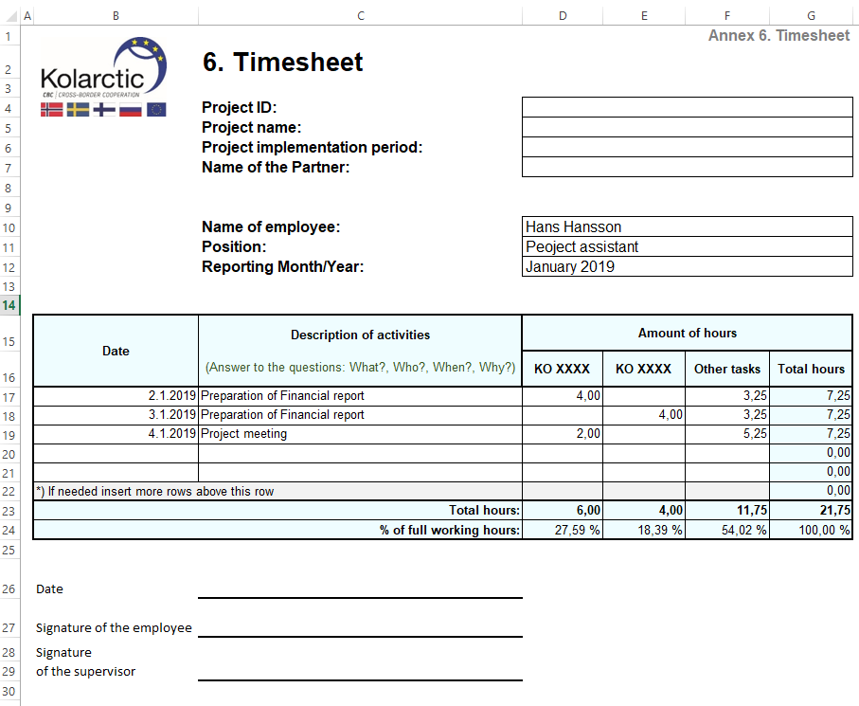
Annex 6. Timesheet
Part-time employees follow their working hours with time sheets
Electronic or manual follow up
Employee fills in and supervisor approved
If employee works in several Kolarctic projects, all hours shall be followed in the same template, adding columns to each project
Timesheets are checked by the auditor but not submitted to MA or loaded to PROMAS, MA may ask part of them for sample check
Data in timesheet must equal with reported in Annex 2.2. Salary specification

Slide 28
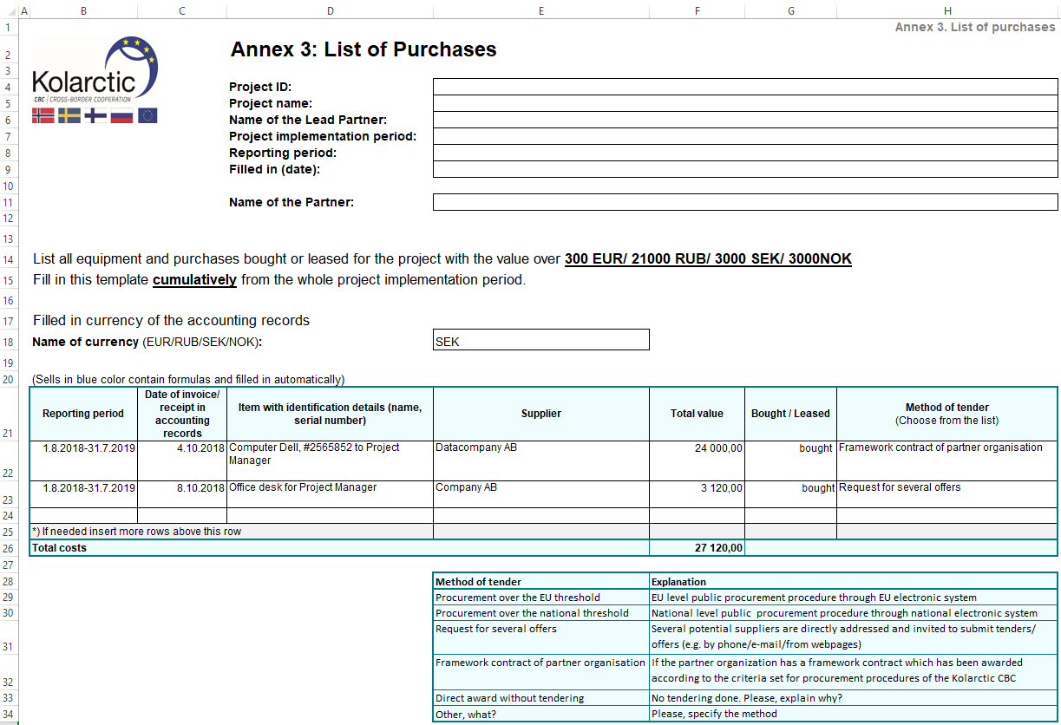
Annex 3. List of purchases
Filled in by each partner
Signed, scanned copy to be loaded in PROMAS
Shall be filled in cumulatively and added to each report
All equipment and purchases with value over 300 € /21000RUB/3000SEK/3000NOK to be listed here
Indicate the method of tender, auditor will check the procurement procedure

Slide 29
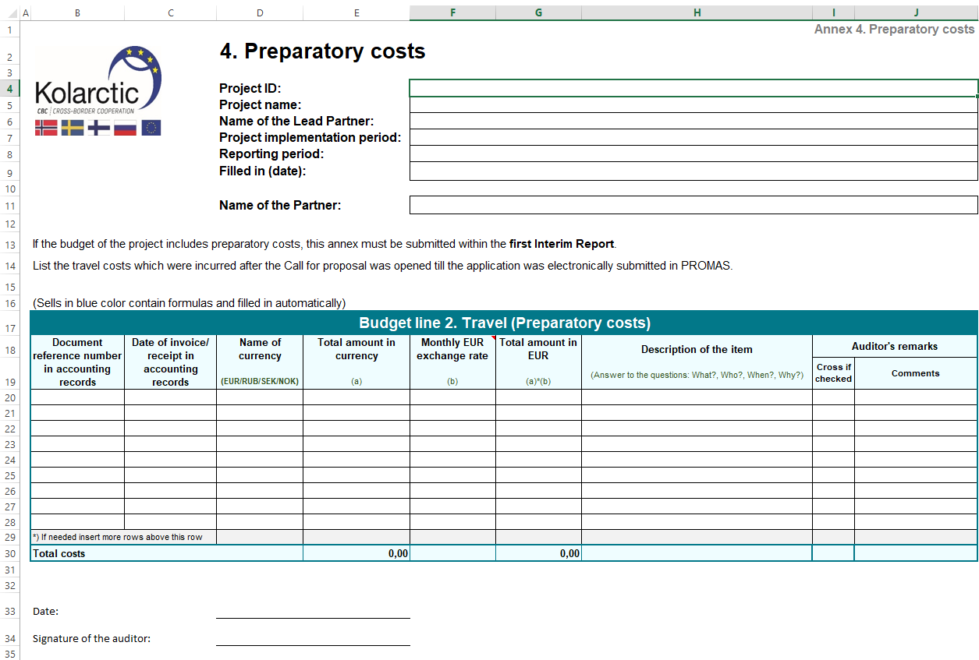
Annex 4. Preparatory costs
Only if your approved budget includes this budget item
Travel costs max. 2000 €/project
Filled in by each partner
Signed, scanned copy to be loaded in PROMAS
Costs have to be reported within first Interim report!

Slide 30
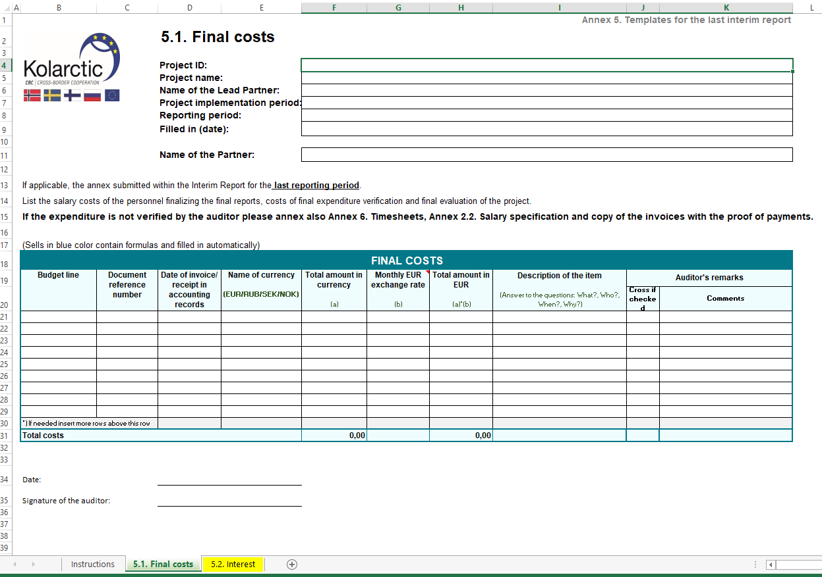
Annex 5. Templates for the last interim report
5.1. Final costs
Costs related to the preparation of the final report are eligible even though the are incurred after the end date of the project
Salary costs, mainly related to the preparation of the final financial report
Audit costs of the last interim report
Evaluation costs if planned to be done

Slide 31
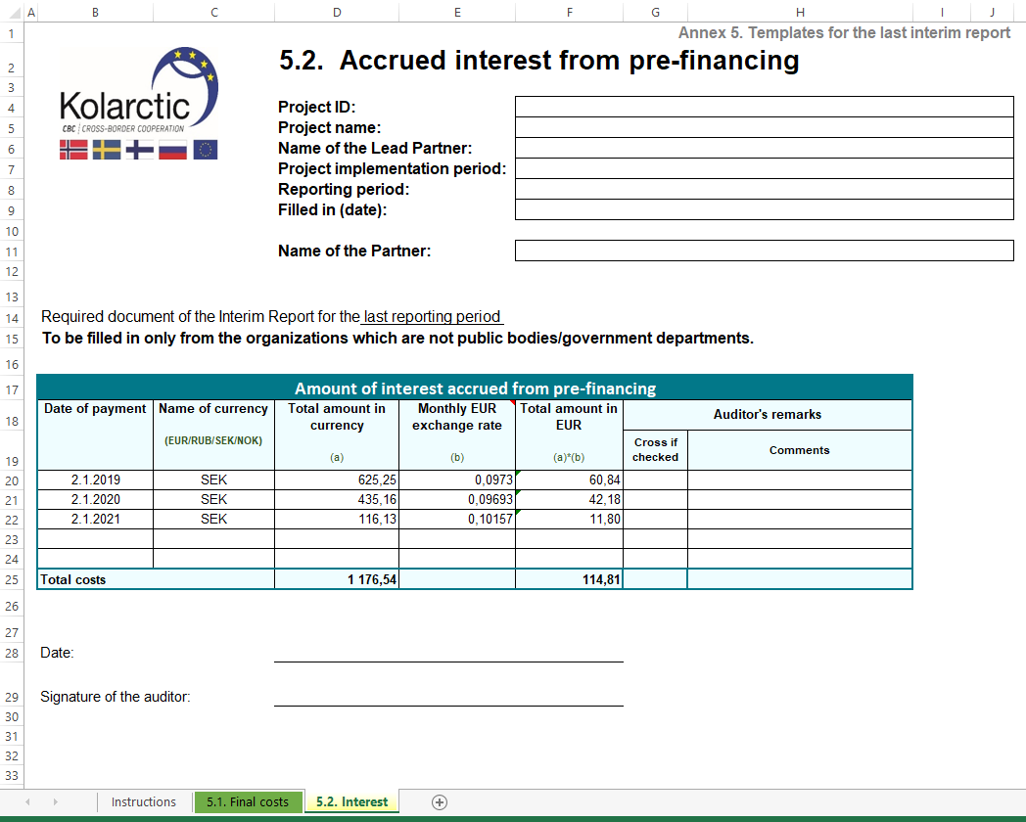
Annex 5. Templates for the last interim report
5.2. Interest
To be filled in only from the organizations which are not public bodies/government departments
Indicate the amount of interest accrued on the bank account from pre-financing paid by the MA during the whole implementation period.

Slide 32
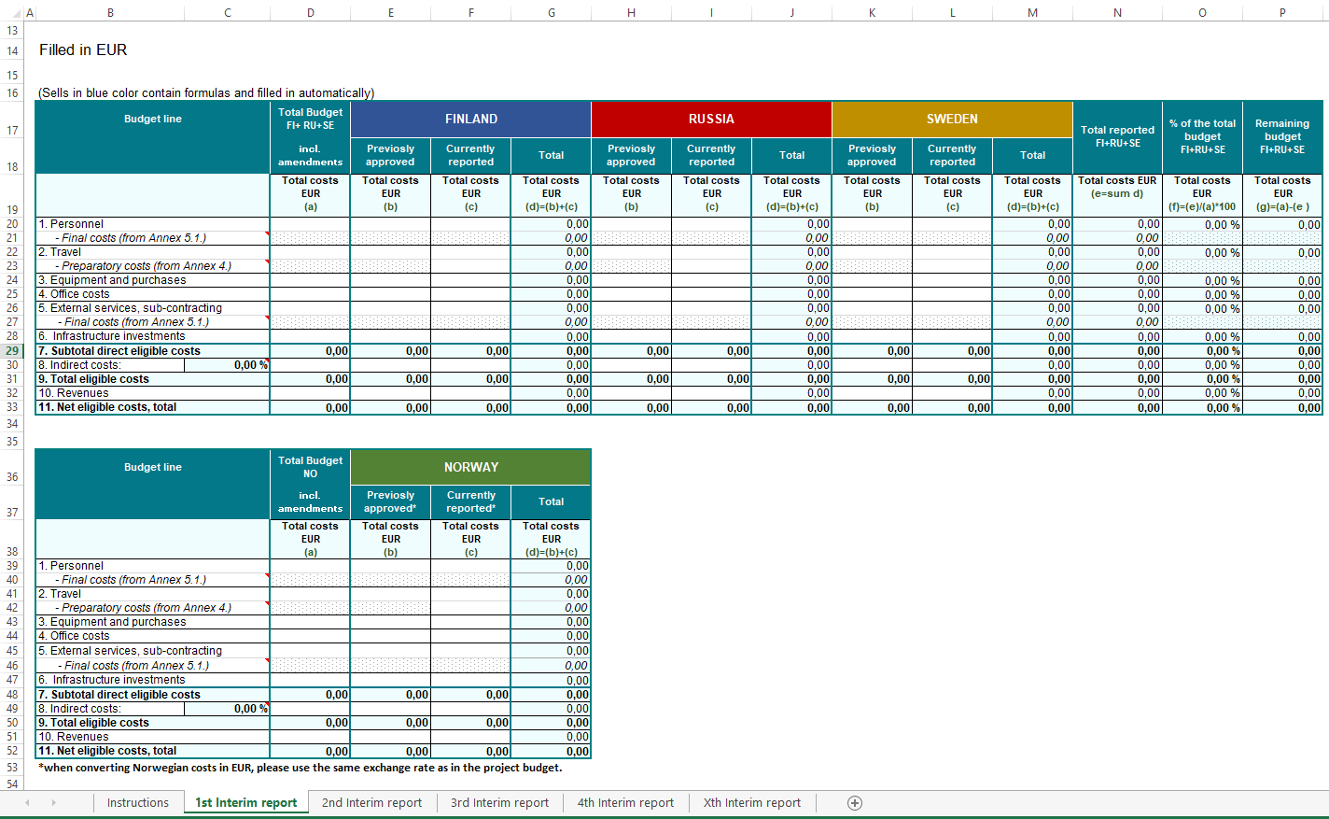
Annex 7. Consolidated financial report
Filled in only by LP
Cumulative amounts from all the partners for current reporting period from annexes 1.1. Financial report.
Only main budget line
Remember Preparatory and Final costs
LP’ auditor verify that the sum is equal with the individual verification reports from the partners
Excel-file to be loaded in PROMAS, signed paper version to be submitted to MA

Slide 33
Reporting periods / due dates
Reporting period shall be agreed with the LP in the first months of the project implementation, period can be 6-12 months
Interim report must be submitted to MA latest 3 months after the reporting period ends and final report latest 4 months after the end date of the project.
MA has 45 calendar days to check the reports (for financial and narrative part separately)
Partners have 30 calendar days to answer to MA questions

Slide 34
Thank you!
Kolarctic Financial Unit
Katri Niska-Honkonen
Financial Manager
Katri.niska-honkonen@lapinliitto.fi
Svetlana Peltoperä
Financial Officer
Svetlana.peltopera@lapinliitto.fi

